Slide 1
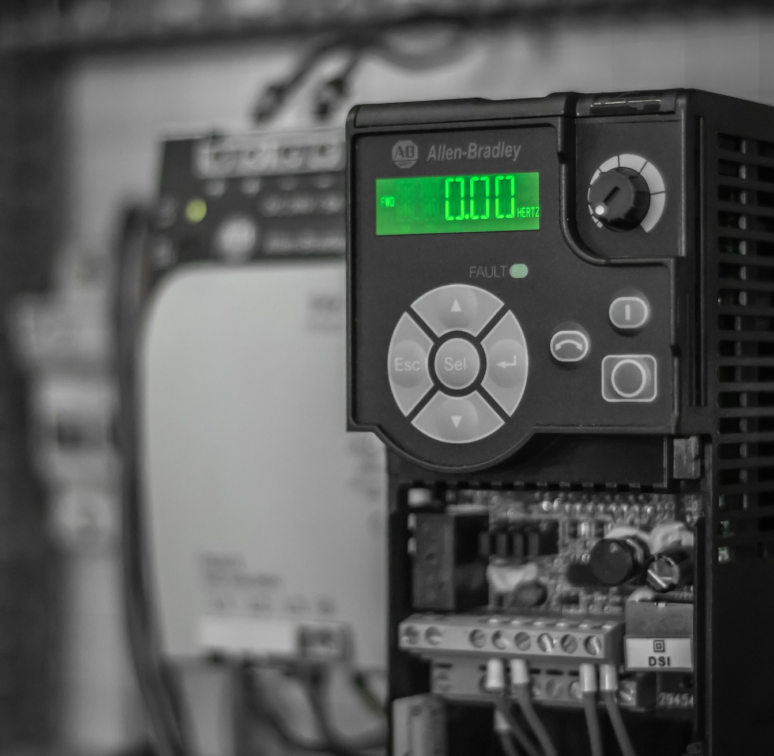
PLC ARCHITECTURE
Industrial Automation
Guide : Prof. Anil Kadu
Image regenerated from: https://pixabay.com/photos/drive-electronics-technology-modern-3645530/

Slide 2

Agenda
About PLC
Types of PLC
Main Components of PLC
Hardware components
Software components
PLC manufactures
Concluding remarks
Referances

Slide 3
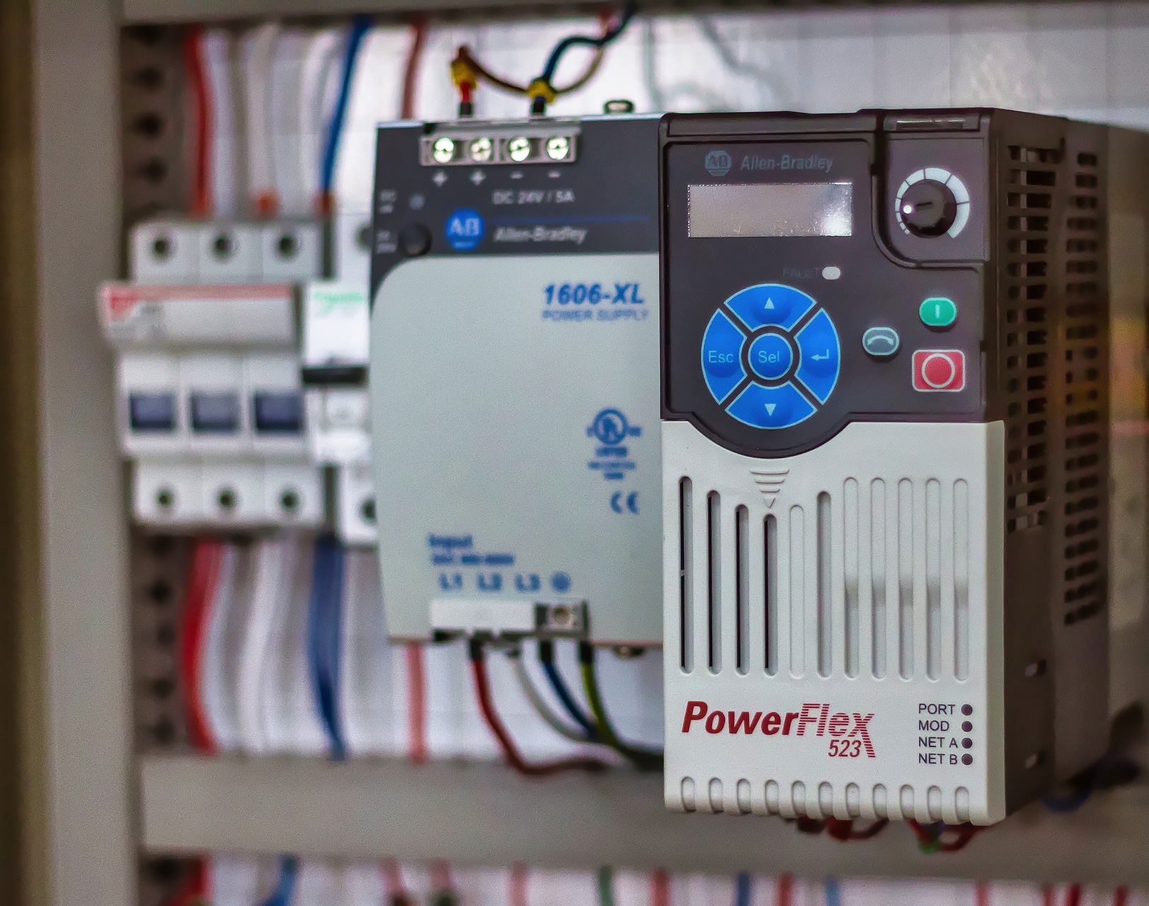
What is PLC?^{[1]}
Programmable Logic Controller
Ruggedized computer used for industrial automation.
Automate a specific process, machine function.
Image regenerated from: https://pixabay.com/photos/drive-electrical-industry-plc-5079720/

Slide 4
Types of PLC^{[2]}
Compact type
I/O capability is fixed and determined by the manufacturer. They are used for small scale uses.
Modular type
Modular PLCs or Rack type refers to a certain type of PLCs that connects their power supply, processor unit, and I/O system over a backbone that is actually called Rack.

Slide 5
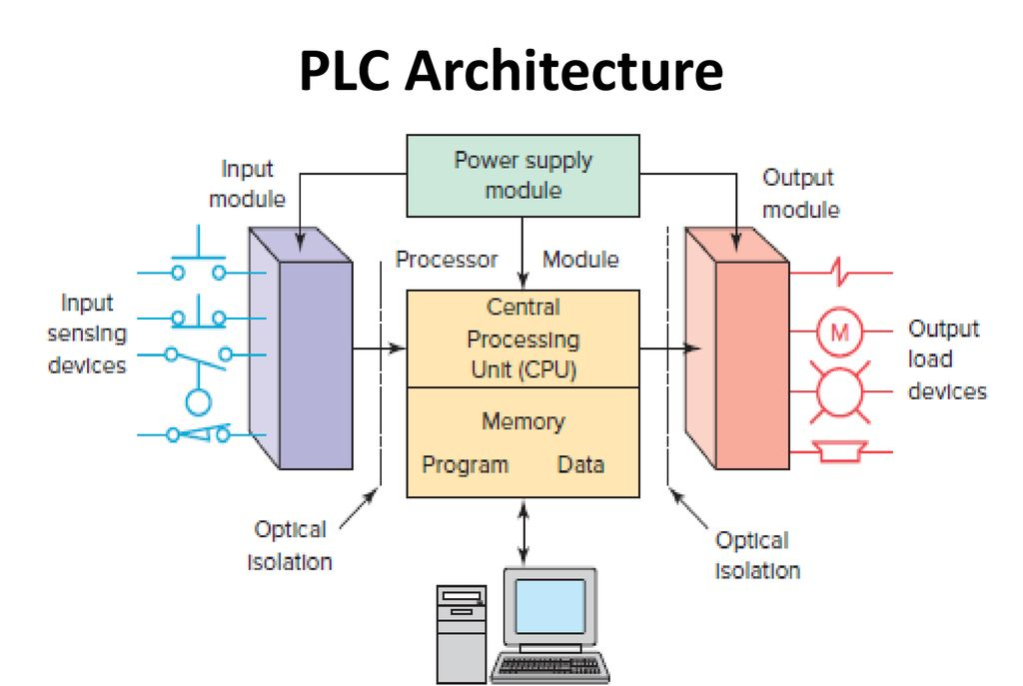
Architecture Diagram
Image regenerated from : https://slideplayer.com/slide/13936021/#.YVko5PdtLBk.whatsapp

Slide 6
Main components of PLC^{[4]}
PLC software and programming
Ladder Diagrams
Structured Text
Function Block
Sequential Function Chart
Hardware
Input/ Output (I/O) section
Power supply
Central Processing Unit (CPU)
Programming device

Slide 7
Input and Output Modules^{[3]}
Responsible for accepting the inputs from input field devices and conveying the output to the output field devices.
Input can be analog or digital.
I/O modules can be of two types:
Fixed
Modular

Slide 8
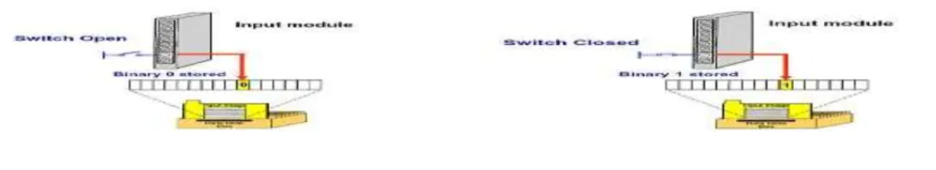
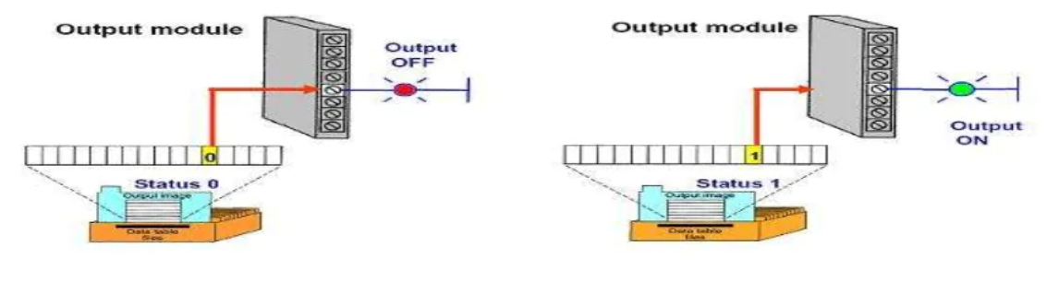
I/O module functioning^{[5]}

Slide 9
Latching^{[7]}
We need a constant logic supply when it comes to storing a bit
If we use input devices like push buttons it connects momentarily
To overcome this Latching concept is used where one button is used to Turn ON and another NC switch is used to Turn OFF the action

Slide 10
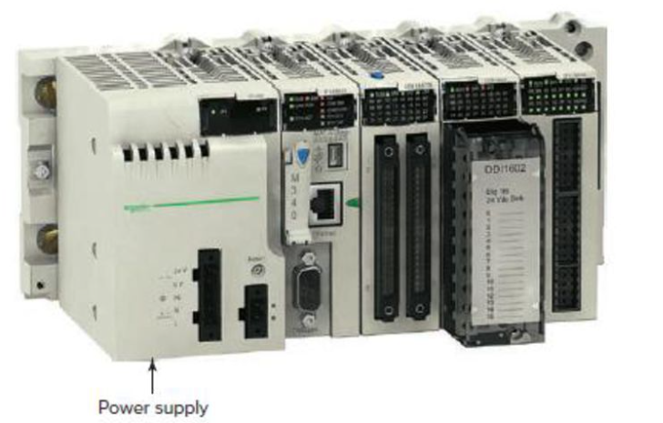
Power Supply
Supplies 24 V DC power to other modules that plug into the rack.
Supply for field devices.
Image reffered from : https://slideplayer.com/slide/13936021/#.YVko5PdtLBk.whatsapp

Slide 11
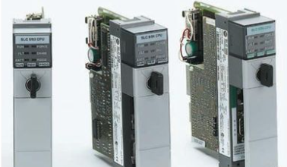
Central Processing Unit (CPU)^{[3]}
CPU is the brain of the PLC.
Consists of a microprocessor, memory chip and
integrated circuits.
Image reffered from : https://slideplayer.com/slide/13936021/#.YVko5PdtLBk.whatsapp

Slide 12
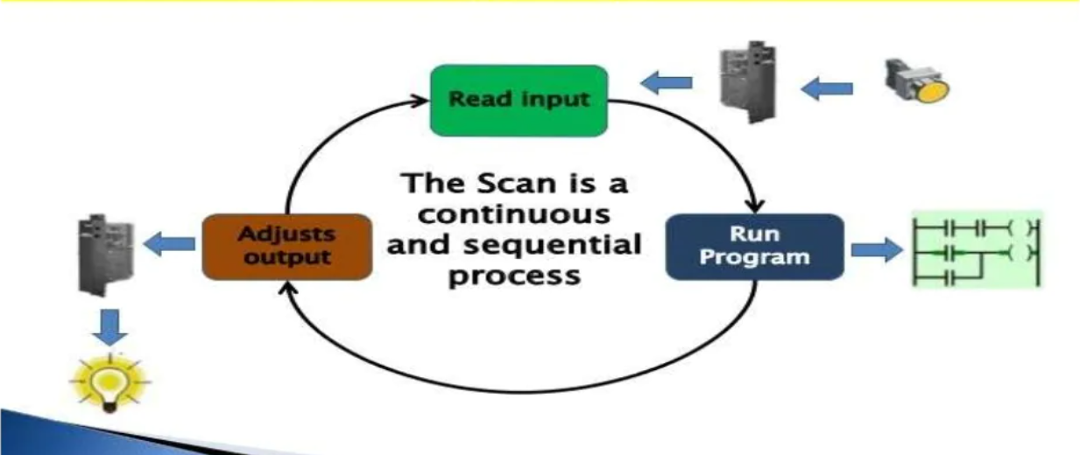
The Scan Cycle^{[5]}
Repetition of process.
Consists of three steps: input scan, executing program(s), and output scan.

Slide 13
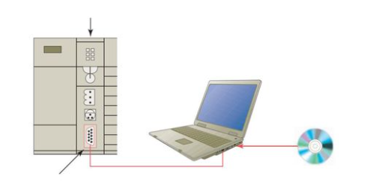
Programming devices^{[3]}
Personal Computer
Handheld devices:
can be used to program small PLCs.
Used to enter and monitor programs.
Most used programming device
Allows users to create, edit, document, store, and troubleshoot ladder logic programs

Slide 14
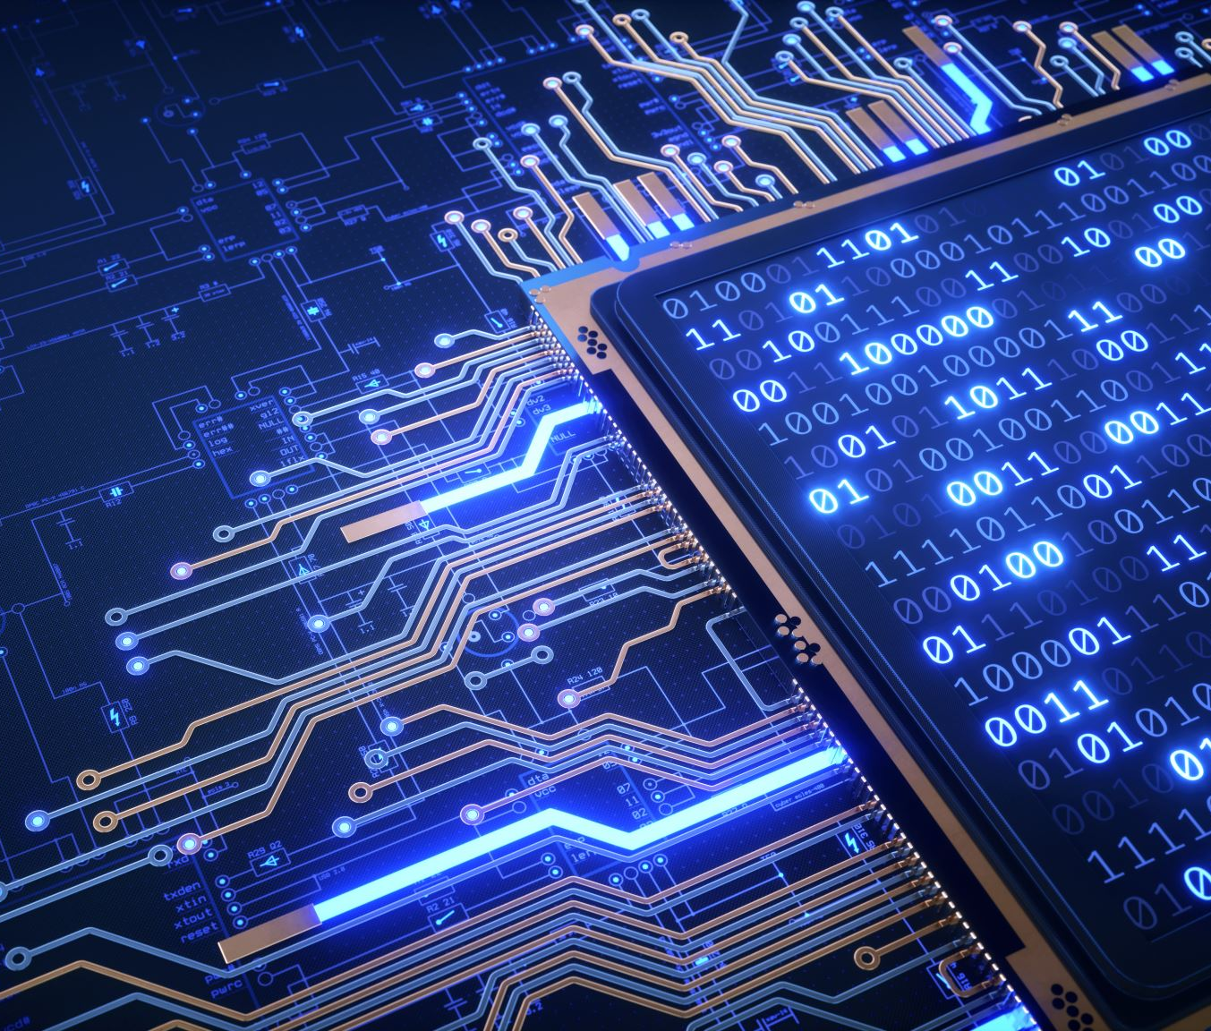
PLC programming^{[5]}
Commonly used language is ladder language of PLC.
Ladder logic : developed to mimic relay logic
Structured Text Programming
Functional Block Programming
Sequential Functional Chart

Slide 15

PLC Manufacturers^{[6]}
Allen bradley
Siemens
DELTA
Mitsubishi
Omoron
Keyence

Slide 16
Conclusive Remarks
Highly customized systems.
More robust .
Require less maintenance.
Excellent solution for many different problems.
Best option for a variety of industrial automation applications.
Greater programming flexibility and ease .

Slide 17
References
^{[1] “}What is a PLC?” , Unitronics Development & Design : G-M agency
^{[2]} "PLC: Programmable Logic Controller", JavaTpoint
^{[3]} "Architecture of PLC", K Samba Siva Rao
^{[4]} "Components of PLC", Instrumentation tools
^{[5]} "PLC Architecture",Pranav Automation,2018
^{[6]} "Top 20 programmable logic controller manufacturers" Sam Francis, July 2020, Robotics and Automation News
^{[7]} B. Tomar and N. Kumar, "PLC and SCADA based Industrial Automated System," 2020 IEEE International Conference for Innovation in Technology (INOCON), 2020, pp. 1-5, doi: 10.1109/INOCON50539.2020.9298190.

Slide 18
Thank You
Presentation By: TY-IC-C (Group - 2)
Aditya Rotithor (27)
Adarsh Sapkal (32)
Shaunak Deshpande (39)
Shrawani Shinde (46)

